Slide 1
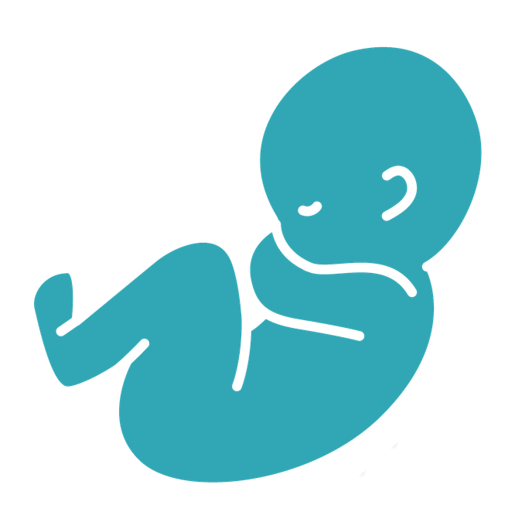

WHO IS SACRED?
...for the kingdom of God belongs to such as these.
Mark 10:14
W
National alk Life
for
MAY 2, 2026 | COMPASSCAREWALK.COM

Slide 2

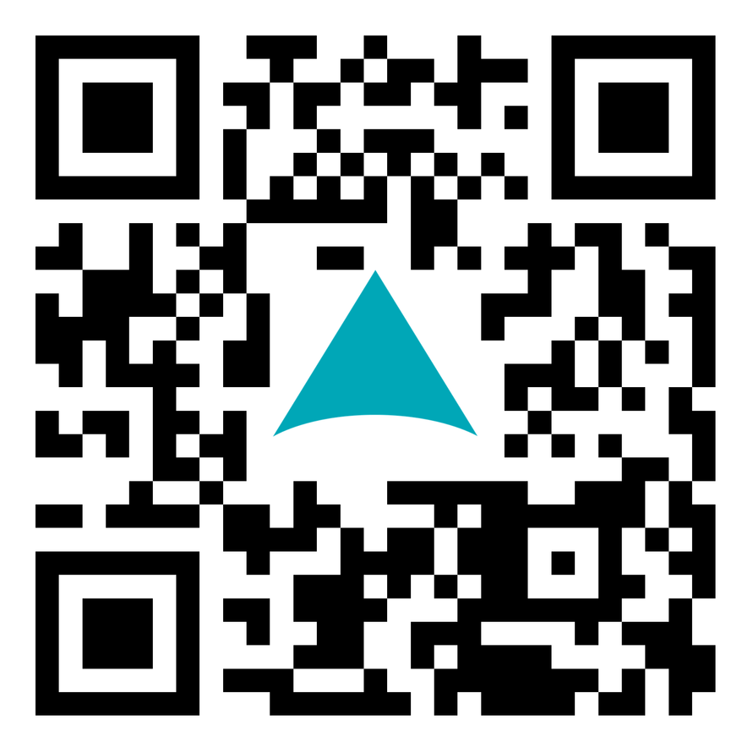

2026 National
W
alk Life
for
SATURDAY, MAY 2
  Educate your community about the sacredness of each person, both mom and baby.
  Save 1,320 women and babies from abortion in New York’s frontline medical mission.
Learn how you can join or host a Walk:
CompassC
re
W
alk.com

